Slide 1

DeepFake Detection
How to run the application

Slide 2

Steps
Clone
Clone the repository in github
Change
Change directory to the project folder in your terminal “cd /your-directory/deep”
Run
Run the requirements.txt file ”pip install –r requiremets.txt”
Run
Run the application “python app.py”
Paste
paste http://127.0.0.1:8000/ in your browser
Select
select a sample video and click the “predict” button

Slide 3
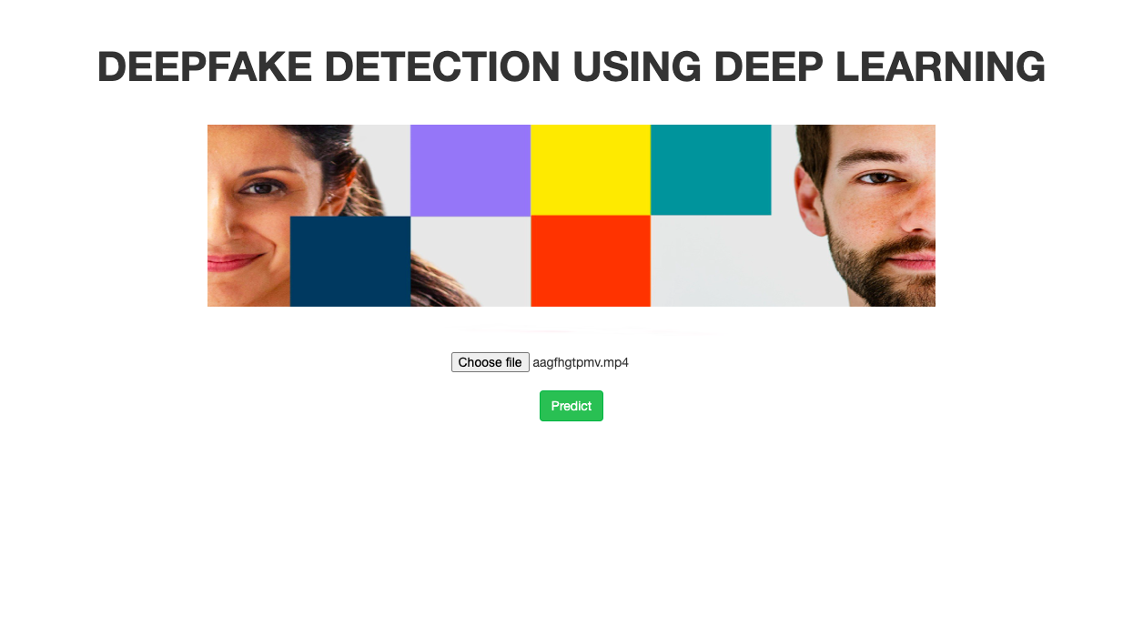
Home Page

Slide 4
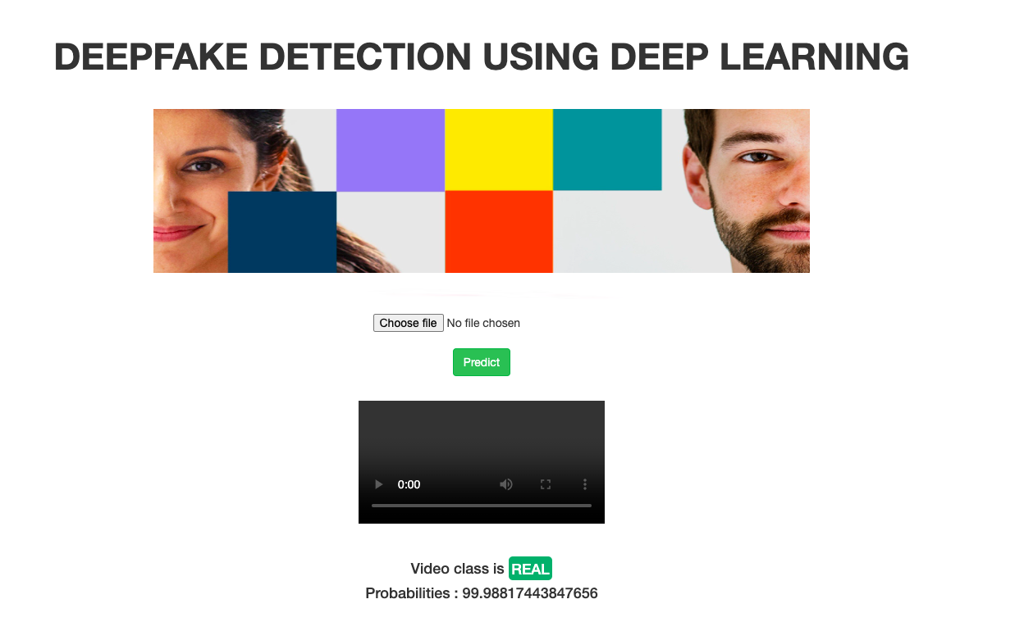
Predict Page

Slide 5
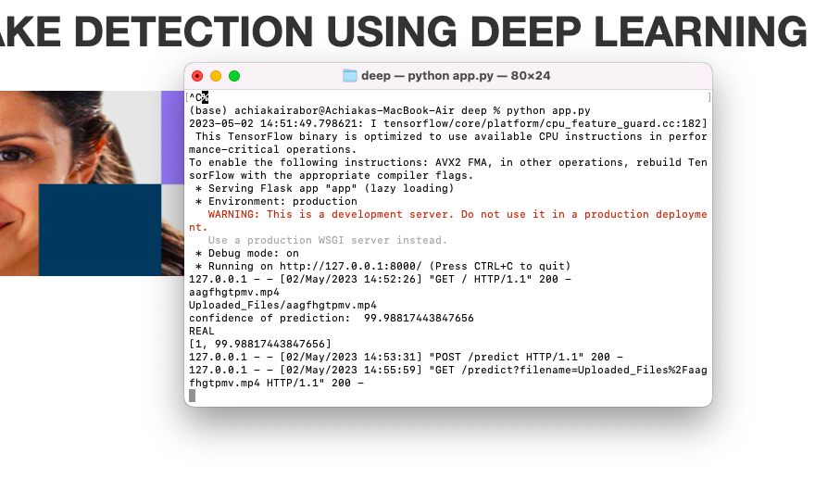
Terminal

